Slide 1
The World of Sabermetrics:
Where Statistics and Sports Meet
High School Statistics
Created by Geoff Combs

Slide 2
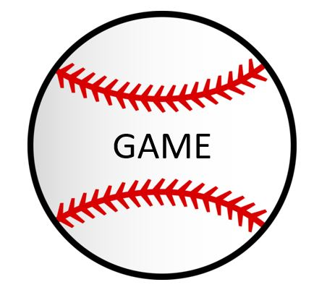
Overview and Directions
Sabermetrics is the use of statistics in baseball. Although there are many more in depth uses, we’ll be focusing on the ideas of expected value and probability on this trip. In addition, we’ll look at how selected statistics are distributed among everyday players in terms of being symmetric or skewed. Watch this video for a demonstration of the use of technology with baseball statistics
Objectives:
Students will be able to identify histograms as being symmetric, skewed to the left, or skewed to the right with 100% accuracy.
Students will be able to research a career field that uses statistics as a Data Statistician at ESPN
Students will be able to recognize baseball acronyms with 90% accuracy in a game setting
Click on the Icons at the Bottom of the screen to navigate through different parts of this trip. It is recommended to go straight through the icons, but you can go in any order you’d like.
When finished, click on the World Series trophy link in the top right to view the sources used and covered state standards

Slide 3
Statistics Vocabulary Words Used
Expected Value – The value of a probability distribution one would expect to get on average of over many trials
Probability – A number between 0 and 1 that describes the proportion of times the outcome would occur in a very long series of repetitions
Histogram – A graph used to show the distribution of a quantitative variable
Symmetric – The right and left sides of the graph are approximately mirror images of each other
Skewed – When one side of graph is much longer than the other side

Slide 4
Find out all the Baseball “Lingo”
Click on the “Sports News” icon on the left which will take you to the glossary page on MLB.com to find definitions for all of the baseball statistic terminology!
You’ll need these terms later!!

Slide 5
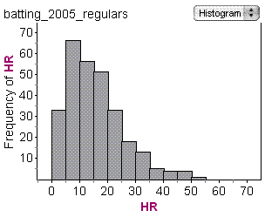
Symmetric or Skewed??
From this histogram courtesy of http://bstats.blogspot.com/2006_05_01_archive.html, the graph of Home Runs in 2005 by regular players is:
Symmetric
Skewed to the Left
Skewed to the Right

Slide 6
Symmetric or Skewed??
That’s right! Like many counting statistics in baseball, the graph of home runs in 2005 is skewed to the right!!
Symmetric
NEXT
Skewed to the Left
Skewed to the Right

Slide 7
Symmetric or Skewed??
Be careful! This graph is certainly not balanced on both sides and has a distinct tail going out to the right. That makes it skewed to the right!
Symmetric
NEXT
Skewed to the Left
Skewed to the Right

Slide 8
Symmetric or Skewed??
Be careful! You notice that it’s skewed, but remember that the direction of the tail is the direction it is skewed! So this would be skewed to the right!
Symmetric
NEXT
Skewed to the Left
Skewed to the Right

Slide 9
Symmetric or Skewed??
From this histogram courtesy of http://bstats.blogspot.com/2006_05_01_archive.html, the graph of On-Base Percentages in 2005 by regular players is:
Symmetric
Skewed to the Left
Skewed to the Right

Slide 10
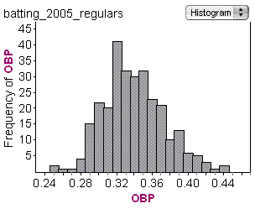
Symmetric or Skewed??
That’s right! Like most derived statistics using a formula, this graph is fairly balanced on both sides, making it symmetric!
Symmetric
Skewed to the Left
NEXT
Skewed to the Right

Slide 11
Symmetric or Skewed??
Not quite! This graph is fairly balanced around that peak in the middle. That would make this graph to be symmetric!
Symmetric
Skewed to the Left
NEXT
Skewed to the Right

Slide 12
Symmetric or Skewed??
Not quite! This graph is fairly balanced around that peak in the middle. That would make this graph to be symmetric!
Symmetric
Skewed to the Left
NEXT
Skewed to the Right

Slide 13
Baseball Statistics in the Movies
Click on the Oakland Athletics logo to see a clip from “Moneyball” about baseball statistics and their use in predictions by using expected value and probability.

Slide 14
Think you have the Baseball Lingo down?
Click on the question mark to go to a Sporcle game to see if you can fill in the words to go with the acronyms! Good luck getting them all!

Slide 15
Think You Want to Work at ESPN? Click Below and see!

Slide 16
Sources
Definitions paraphrased from “The Practice of Statistics: Fifth Edition” by Starnes, Tabor, Yates, and Moore.
All videos found through YouTube
Glossary is from MLB.com
Histograms are courtesy of http://bstats.blogspot.com/2006_05_01_archive.html
Game was found via a search on Sporcle.com

Slide 17
State Standards
S.MD.A.8 Analyze decisions and strategies using probability concepts (e.g., product testing, medical testing, pulling a hockey goalie at the end of a game).
S.MD.A.7 Weigh the possible outcomes of a decision by assigning probabilities to payoff values and finding expected values.
b. Evaluate and compare strategies on the basis of expected values. For example, compare a high-deductible versus a low-deductible automobile insurance policy using various, but reasonable, chances of having a minor or a major accident.
S.ID.A.5 For univariate measurement data, be able to display the distribution and describe its shape; select and calculate summary statistics.

